Slide 1
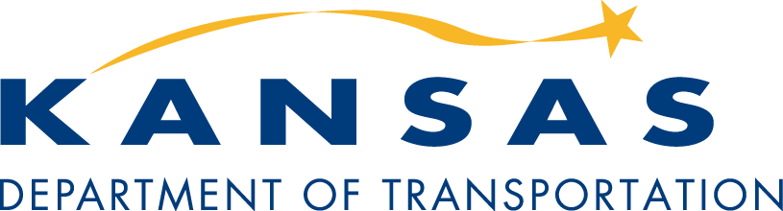
Federal Fund Exchange
Training

Slide 2
What is the
Federal Fund Exchange?
This is a voluntary program in which a Local Public Agency can trade its federal obligation authority with KDOT or another local agency in exchange for state funds. State funds are paid on a reimbursement basis as the LPA incurs costs.
Notes:
Program is voluntary.
Requires $ be used on a transportation project. (More later)
Reimbursement program.
Saves dollars/time:
Reduced plan needs in many cases
Avoid cumbersome fed. Requirements
Projects better tailored to local needs – Example: bridge on very low vol. road
More flexibility:
Wider range of projects, for example some maintenance activities are eligible. More later.
Dollars don’t have to be spent on specific classes of roads.

Slide 3
What Are the Benefits of the
Fund Exchange?
Eliminates costly and time-consuming requirements of federal-aid projects.
  Reduced environmental documentation
  Plans development to meet local needs
  Inspection to meet local needs
  Avoid many restrictive federal provisions
      Buy America
      Davis-Bacon
      DBE
      Uniform Act
      Pipe Policy

Slide 4
What Are the Benefits of the
Fund Exchange?
More flexibility in selection of projects
  Projects can be on non-federal aid routes
  Bridges don’t have to meet eligibility requirements
  Much wider range of scopes allowed

Slide 5
“Transportation Project”
Road construction, reconstruction, rehabilitation
Pavement preservation (overlay, mill/overlay, chip/seal, pvt. patching, crack sealing)
Purchase of aggregate used exclusively on a specific section of road
Safety improvement (signing, pvt. marking, roadside obstacles, intersection, etc.)

Slide 6
“Transportation Project”
Bridge construction/replacement
Bridge rehabilitation, repair
Bridge removal
Low-water crossing

Slide 7
“Transportation Project”
Erosion protection in ditches or around drainage structures.
Const. of sidewalks, ADA ramps, pedestrian signals.
Construction of trails.
Curb & Gutter repair or replacement.
Storm sewer repairs.

Slide 8
Allowable Use of State Funds
All phases of project are eligible.
LPA determines procedures, criteria and standards.
  Must meet applicable laws, regulations, accepted engineering practices.
Funds must be requested prior to September 15 of Federal Fiscal Year they were made available.
Notes:
Transportation project: Defined in Guidelines. See list
Eligible phases: PE, R/W, Util., Construction, CE
Project doesn’t have to be done the “KDOT way”.
Local standards and practices may be followed.
All applicable laws, regulations and engineering practices must be met.
Reimbursement on projects may be for the entire project or we can make “progress payments” to help the LPA manage its cash flow.

Slide 9
Current Fed.-Aid Process
Federal funds are made available to KDOT through FHWA.
KDOT shares a portion of federal funds with cities and counties.
FHWA
KDOT
City/County
LPA develops project.
KDOT lets/administers project with federal/local funds
Notes:
Project must meet federal rules and requirements. Example: NEPA
Project standards and specs established by KDOT & FHWA rules.
Plan development must be in accordance with KDOT practices.

Slide 10
How the Fund Exchange Works
Federal funds are made available to KDOT through FHWA.
KDOT shares a portion of federal funds with cities and counties.
FHWA
KDOT
City/County
KDOT agrees to provide LPA $0.90 state funds per $1.00 fed. with rate to be determined annually by the Secretary of Transportation
LPA requests KDOT exchange funds.
Notes:
Local agency determines appropriate standards, specifications, plan requirements.

Slide 11
How the Fund Exchange Works
KDOT reimburses LPA up to maximum amount of total exchange.
KDOT
City/County
LPA submits request for reimbursement to KDOT along with appropriate documentation of expenditure.
LPA lets/administers project(s) themselves and pays contractor/suppliers.
Notes:
Local agency determines appropriate standards, specifications, plan requirements.

Slide 12
Fed. Funds Available for Exchange
5-Year Plan funds (STP Limitation)
  Counties: $30.5 million (FFY 2024)
  Cities: $11.3 million (FFY 2024)
Minus Federal-Aid Local Bridge Program.
  Approx. $10 million annually.
Minus Local Bridge Inspection Compliance Effort.
  Approx. $5 million annually.
  Through 2024.

Slide 13
Eligibility
All counties
Cities over 5,000 not in a TMA.

Slide 14
“FFE Letter”
Letter will:
  Tell you how many fed $ available for year
  Give you option of either programming fed-aid project or requesting exchange.
  Provide deadline for informing us of decision.

Slide 15
What do I need to do to exchange my federal funds?

Slide 16
Understand the Rules

Slide 17
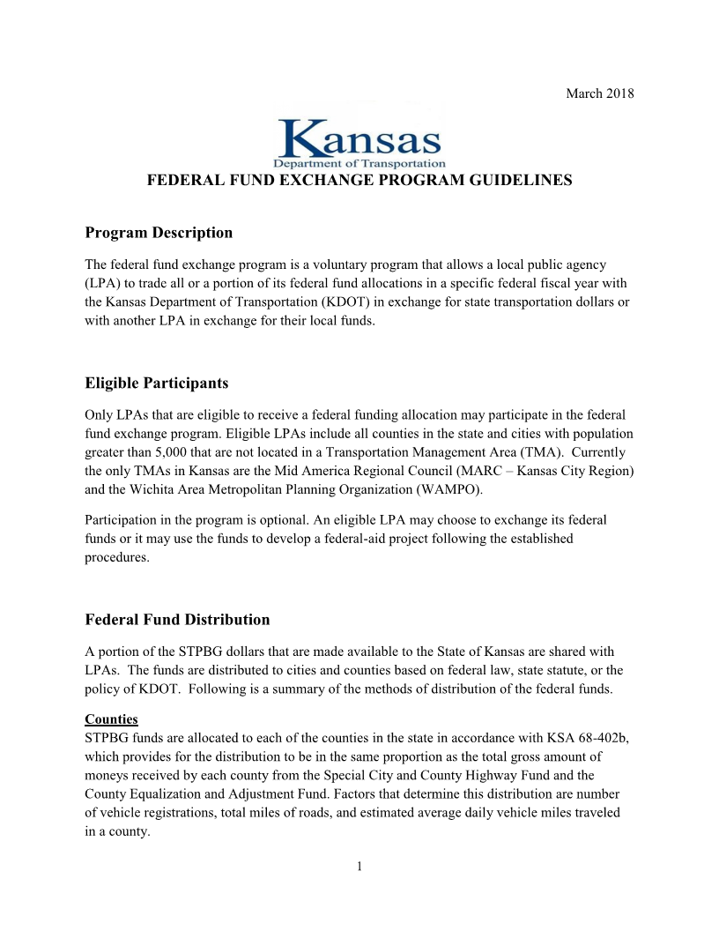

Slide 18
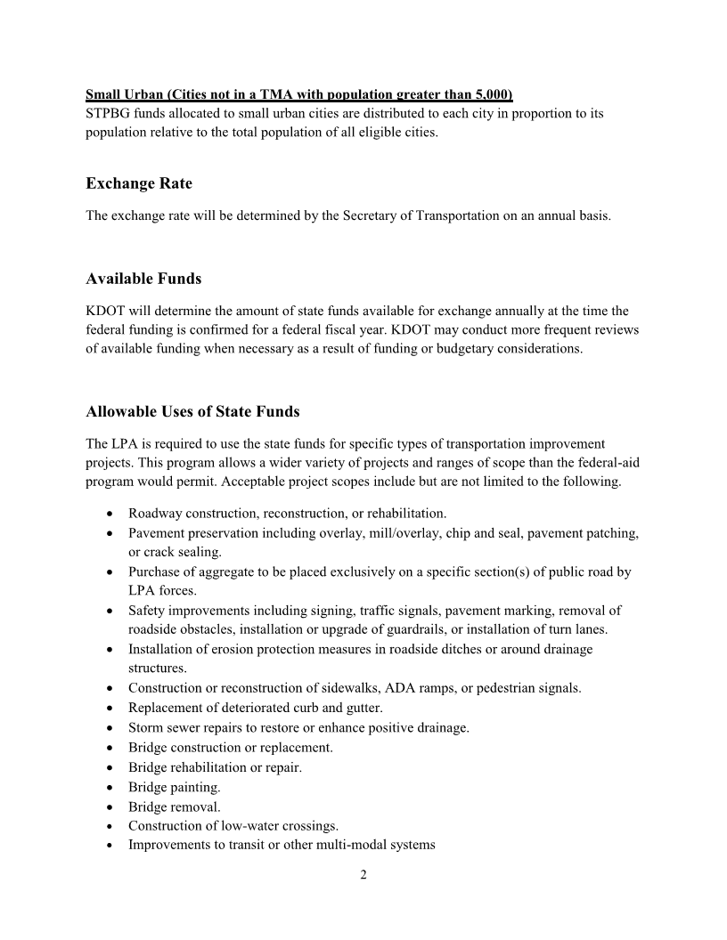

Slide 19
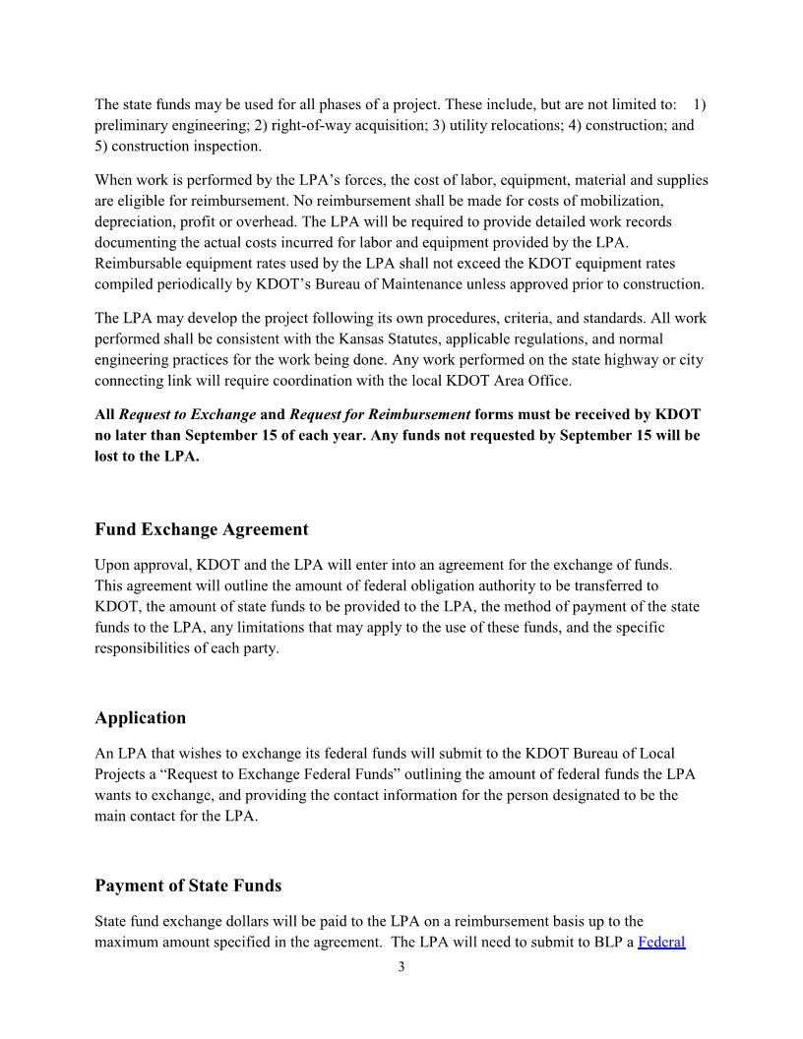

Slide 20
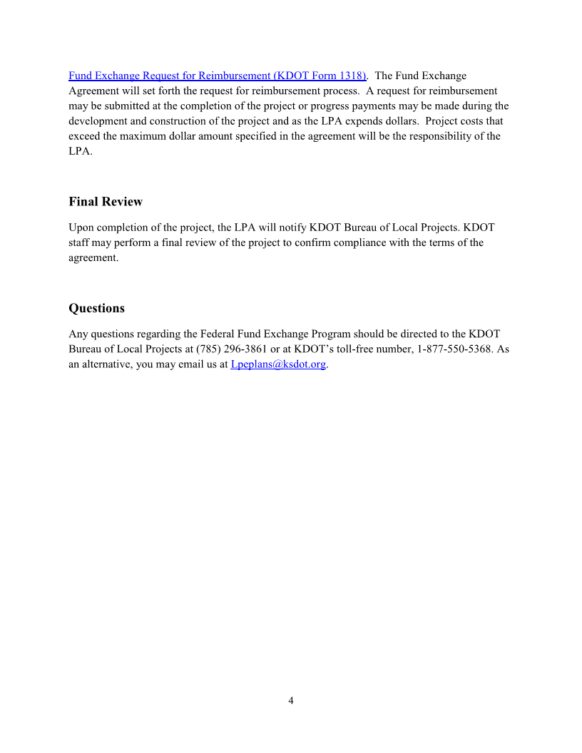

Slide 21

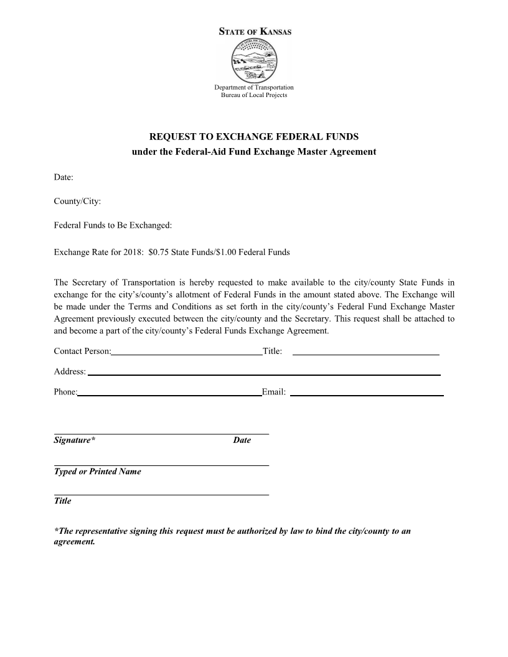

Slide 22
Request is submitted to KDOT, now what?

Slide 23
KDOT reviews request, determines if projects meet program requirements

Slide 24
Reimbursement Process

Slide 25
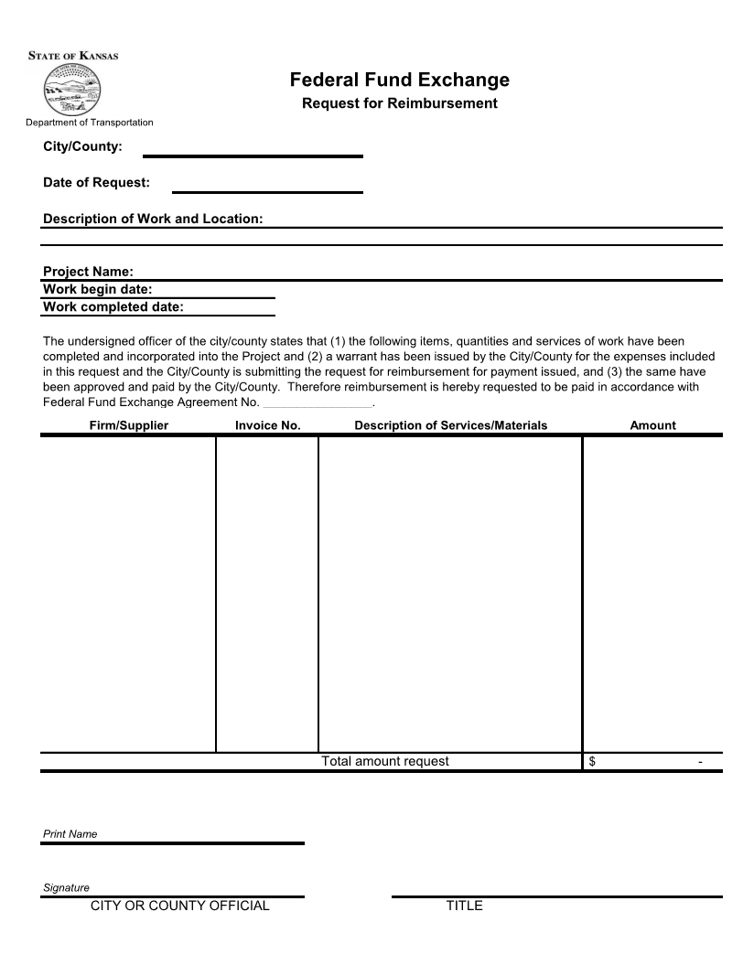

Slide 26
Statutes, Regulations &
Engineering Practices

Slide 27
Questions?

