Slide 1


Guide to Creating Active Transportation Maps
Microsoft PowerPoint Map Templates and How-to Guide
For more Active Transportation Planning Resources, visit the KDOT Active Transportation Planning Toolkit webpage

Slide 2
Introduction & Purpose
Maps are one of the most valuable components of an Active Transportation Plan. Maps help communicate:
Existing pedestrian and bicycle infrastructure
Planned pedestrian and bicycling infrastructure
Popular destinations, such as parks, schools, and commercial areas
Barriers to walking and biking, such as highways, railroad tracks, or rivers
This guide was developed as a tool for small communities in Kansas that are interested in developing active transportation maps but don’t have previous map making experience or access to sophisticated map making tools. It provides step-by-step instructions for how to build simple maps within Microsoft PowerPoint. Within a few hours, you can follow the 5 simple steps outlined in this guide and easily create a customized map for your community’s Active Transportation Plan!

Slide 3
Additional Mapping Resources
Depending on your community, you may have access to mapping software and professionals who can help you with mapping and data tasks.
Before getting started, consider reaching out to one of the following to ask for help with mapping:
  Metropolitan Planning Organization/Regional Transportation Planning Organization
  County Planning Commission
  County Engineer
  County Auditor
  Planning or Development Department
  Local university (Geography or Planning departments)
If none of the above are available to assist, this guide is for you! Additional mapping resources can be found on the KDOT Active Transportation Resources webpage.

Slide 4
Existing Conditions Mapping
Resources like those listed on the previous page may also have maps and data that are relevant to include. If available, you may want to analyze and include information such as:
      Crashes
      Vehicle volumes
      Bicycle and pedestrian counts
      Existing and planned bicycle routes
      Sidewalk inventory
      Bicycle level of stress
      Community demographics
      Land use
      Points of interest
KDOT’s ArcGIS online mapping page provides a variety of data that may be useful to analyze for your plan. Visit the “Transportation Planning – State System Map” to display maps of traffic volumes, speed limits, and other relevant data on State systems. If desired, you can take screenshots of these maps to include in your plan. For a guide on using this resource, see “Navigating the Kansas State Government GIS: Transportation Planning State System Map” on the KDOT Active Transportation Planning Toolkit webpage.

Slide 5
Basic Map Making Principles
Here are some basic principles to keep in mind as you build your map(s):
Establish a hierarchy. The most important elements should be highlighted. Use of size or contrasting color are two ways to achieve this hierarchy. Street names should be legible but do not need to be as large as the names of important landmarks or destinations.
Avoid clutter. Omit any data that isn’t relevant to your map. Having too much information on the map can be confusing to the reader and obscure the message you are trying to convey.
Make it legible. All information should be readable. Although your map should include a legend, the symbols on the map should be intuitive enough that readers shouldn’t have to constantly refer to it.
Provide enough contrast. There should be enough contrast to easily distinguish elements on the map. Ideally maps should be readable when printed in black and white.

Slide 6
Building Your Map in PowerPoint
Microsoft PowerPoint is a widely-used program for developing presentations and can also be used to build simple planning maps for your community. If you have questions on how to use PowerPoint, please see Microsoft’s PowerPoint help page.
The five basic steps of building your map in Microsoft PowerPoint are listed below. Detailed instructions for each of these steps is provided on the following pages.
Download and save the PowerPoint template
Copy the base map
Add icons to your map
Add and style lines
Export and share your map

Slide 7
1. Download and Save this Template
Download the PowerPoint template (the file you are viewing now) and save it on your computer
You will use the blank mapping templates at the end of these instruction slides to begin building your map
You’ll notice each blank map has placeholder locations where you can enter your community’s name and insert a community logo. Click on those areas and update the fields for your community.
There are also a variety of icons available in the legend of the blank map you can use to map your pedestrian and bicycling routes. These icons can be used to show popular destinations, planned crossing improvement areas, and more.

Slide 8
2. Copy the Base Map
A base map is a basic map showing your community that you will copy and paste into the blank maps available at the end of this PowerPoint.
Open Google Maps (or Bing Maps if you prefer). Click inside the search bar at the top of the page and type your community's name.
  Another option is to use KDOT’s Transportation Planning –State System Map if you would like a “cleaner” basemap with fewer symbols and labels to work with. For guidance, go to KDOT Active Transportation Planning Toolkit
  Zoom to the extent you want your map to cover by using the mouse scroll wheel or the +/- controls at the lower right-hand corner of the screen.
  ­Each mapping platform provides different base map options (Bottom left corner in Google, top right corner in Bing). The default map view is recommended over the aerial/earth view because it’s easier to read. The default in Bing Maps is called “Road”.

Slide 9
2. Copy the Base Map (continued)
Take a screenshot.
  Windows Users—Open the Snipping Tool. Drag the cursor, which appears as a +, over the area you want to capture. Once you release, the snippet window will open with the screen shot. Right click the image and select “copy” or hit CTRL+C simultaneously.
  Macintosh Users—Press “COMMAND+SHIFT+4” simultaneously. Once pressed, the cursor will change to a +. Click and drag to cover the area you want to capture.
Navigate to one of the blank map pages in the PowerPoint template (pp. 10-11). Click within the blank box that says “Click Icon to add picture.” Paste the screen shot image from step 4 into this box.
If your map is zoomed in too close or too far, rescale the map as needed in Google Maps or Bing Maps and repeat steps 4-5.
Now your map is ready to be customized with icons and lines!

Slide 10
3. Add Icons to Your Map
Icons are helpful tools to highlight important locations or destinations in your community, such as parks or schools. To add icons:
Select the icon you wish to add to your map from the legend on the left side of the map templates (slides 14 and 16). Copy the selected icon (Ctrl + C).
Paste the selected icon onto your map page (Ctrl + V). The pasted icon will appear directly under the existing icon in the legend. Drag the pasted icon to the desired location on your map.
Repeat steps 1-2 for any additional locations/destinations

Slide 11
4. Add and Style Lines
Lines can be used to map pedestrian and bicycling routes and other linear features. To add and style lines, follow the directions below:
Select the type of line you wish to add to your map from the legend on the left side of the map templates (slides 14 and 16). Copy that line (Ctrl + C).
Paste (Ctrl + V) the selected line onto your map page. The pasted line will appear directly under the existing line in the legend.
Drag the pasted line to the desired location on your map. If desired, you can change the color or style of the line using the “Shape Format” toolbar at the top of the program.

Slide 12
4. Add and Style Lines (continued)
Use the handles (white circles) at either end of the line to adjust the line’s length and angle.
  Note that PowerPoint can only draw straight lines. If needed, you can line up multiple small line segments to show a line with bends or curves.
  Use the zoom bar in the bottom right to zoom in and out on your map and help with lining up your lines and icons in the correct places.
If you are mapping a pedestrian and bicycling route on the same street, offset the lines so that they are parallel and both modes are visible. Add lines to indicate if sidewalks are present on one or both sides of the street.

Slide 13
5. Export and Share Your Map
Once your draft map is complete, you may want to share it with other community partners to get feedback. To make sure you share the map can be easily shared with everyone and not changed on accident, you should not share the PowerPoint file, but instead export the map to a PDF or image format (.PNG or .JPG) and share that version of the map.
To export your map to PDF, click “File,” “Export,” and “Create PDF/XPS.”
To export your map as an image, click “File,” “Save As,” and select an image type (.PNG or .JPG).

Slide 14





[ CITY/TOWN NAME HERE ] – Existing Walking and Bicycling Routes
Add your community’s
logo here
Existing Sidewalk(s)
Existing On-Street
Bike Route
Existing Off-Street Trail
Park/Open Space
School
City Hall
Grocery Store
Library

Slide 15
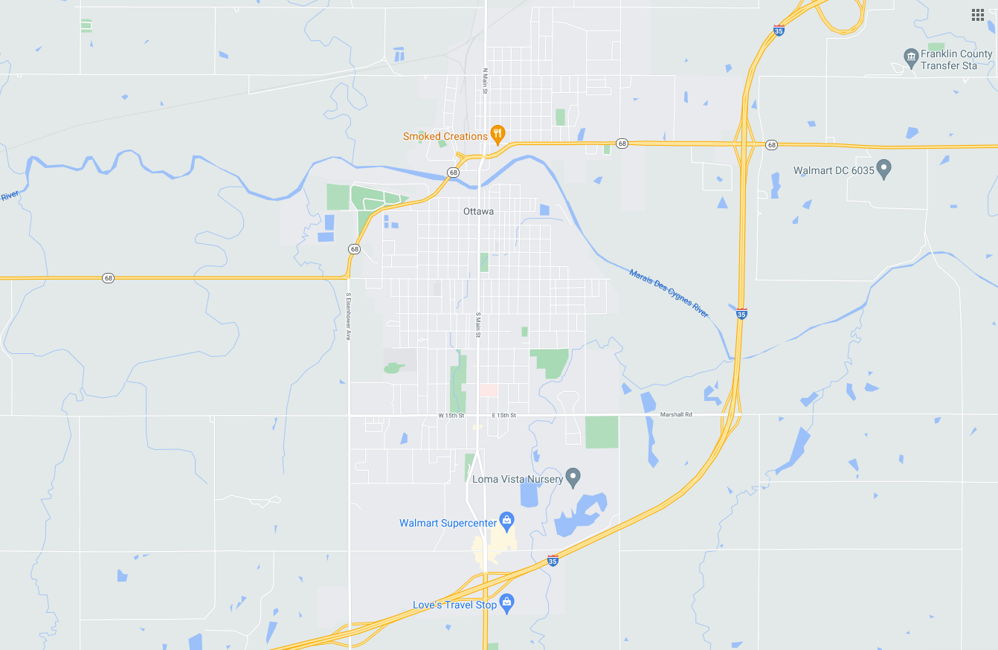
[ CITY/TOWN NAME HERE ] – Existing Walking and Bicycling Routes
Add your community’s
logo here
Existing Sidewalk(s)
Existing On-Street
Bike Route
Existing Off-Street Trail
Park/Open Space
School
City Hall
Grocery Store
Library

Slide 16

[ CITY/TOWN NAME HERE ] – Existing and Planned Walking and Bicycling Routes
Add your community’s
logo here
Existing
Planned
Sidewalk
On-Street Bike Route
Off-Street Trail
Planned Crossing Improvement
Park/Open Space
School
City Hall
Grocery Store
Library

Slide 17
[ CITY/TOWN NAME HERE ] – Existing and Planned Walking and Bicycling Routes
Add your community’s
logo here
Existing
Planned
Sidewalk
On-Street Bike Route
Off-Street Trail
Planned Crossing Improvement
Park/Open Space
School
City Hall
Grocery Store
Library

